Slide 1


VISVESVARAYA TECHNOLOGICAL UNIVERSITY
“JNANA SANGAMA” BELAGAVI- 590018, KARNATAKA
DBMS MINI PROJECT REPORT
On
“Hospital Management System”
BACHELOR OF ENGINEERING
IN
COMPUTER SCIENCE AND ENGINEERING
BY
HARSHITH BABU K THUKARAM RAO A.N.V HARSHA VARDHAN S
( 1RL19CS035 ) ( 1RL19CS001 ) ( 1RL19CS031 )
Under the Guidance of,
Prof. VEENA K
DEPARTMENT OF COMPUTER SCIENCE AND ENGINEERING
R L JALAPPA INSTITUTE OF TECHNOLOGY
DODDABALLAPUR-561 203 (KARNATAKA) 2021-2022

Slide 2


CONTENTS
INTRODUCTION
DESIGN AND ANALYSIS
SYSTEM REQUIREMENTS
IMPLEMENTATION
SNAP SHOTS
CONCLUSION
REFERENCES

Slide 3
INTRODUCTION TO HOSPITAL MANAGEMENT SYSTEM
Introduction
Human Body is a very complex and sophisticated structure and comprises of millions of functions. All these complicated functions have been understood by man him, part-by-part their research and experiments. As science and technology progressed, medicine became an integral part of the research. Gradually, medical science became an entirely new branch of science. As of today, the Health Sector comprises of Medical institutions i.e. Hospitals, HOSPITALs etc. research and development institutions and medical colleges. Thus the Health sector aims at providing the best medical facilities to the common man
2. Problem Statement
Since Hospital is associated with the lives of common people and their day-to-day routines so I decided to work on this project. The manual handling of the record is time consuming and highly prone to error. The purpose of this project is to automate or make online, the process of day-to-day activities like doctor booking,Admission of New Patient, Details of appointed Patient, Assign a Doctor, and finally compute the over-view of details etc. I have tried my best to make the complicated process Hospital Management System as simple as possible using Structured & Modular technique & Menu oriented interface.
I have tried to design the software in such a way that user may not have any difficulty in using this package & further expansion is possible without much effort. Even though I cannot claim that this work to be entirely exhaustive, the main purpose of my exercise is perform each Hospital’s activity in computerized way rather than manually which is time consuming.I am confident that this software package can be readily used by non-programming personal avoiding human handled chance of error

Slide 4
3. Objective
Hospital are the essential part of our lives, providing best medical facilities to people suffering from various ailments, which may be due to change in climatic conditions, increased work-load, emotional trauma stress etc. It is necessary for the hospitals to keep track of its day-to-day activities & records of its patients, doctors, and other staff personals that keep the hospital running smoothly & successfully.
But keeping track of all the activities and their records on paper is very cumbersome and error prone.It also is very inefficient and a time-consuming process Observing the continuous increase in population and number of people visiting the hospital. Recording and maintaining all these records is highly unreliable, inefficient and error-prone. It is also not economically & technically feasible to maintain these records on paper.
The main aim of our project is to provide a paper-less hospital up to 90%. It also aims at providing low-cost reliable automation of the existing systems. The system also provides excellent security of data at every level of user-system interaction and also provides robust & reliable storage and backup facilities.
4. Scope
The proposed software product is the Hospital Management system (HMS). The system will be used in any hospital, clinic, dispensary or pathology labs. Clinic, dispensary or pathology to get the information from the patients and then storing that data for future usages. The current system in use is a paper based system. It is too slow and cannot provide updated lists of patients within reasonable time frame. The intention of the system is to reduce over-time pay and increase the number of patients that can be treated accurately. Requirement statements in these documents are both functional and non-functional.

Slide 5
Project Management
2.1 Project planning and scheduling
Project planning is part of project management, which relates to the use of schedules such as Gantt charts to plan and subsequently report progress within the project environment. Initially, the project scope is defined and the appropriate methods for completing the project are determined. Following this step, the durations for the various tasks necessary to complete the work are listed and grouped into a work breakdown structure. The logical dependencies between tasks are defined using an activity network diagram that enables identification of the critical path.
2.2 Methodology
We have used Iterative and Incremental Development model (IID) for our project development. This development approach is also referred to as Iterative Waterfall Development approach. Iterative and Incremental Development is a software development process developed in response to the more traditional waterfall model. This model is designed to take care of such big project. The large and complicate project chiefly demand better development and testing procedure. The waterfall model is well known for its repeated testing process. Hence I choose the waterfall model for developing my software.

Slide 6
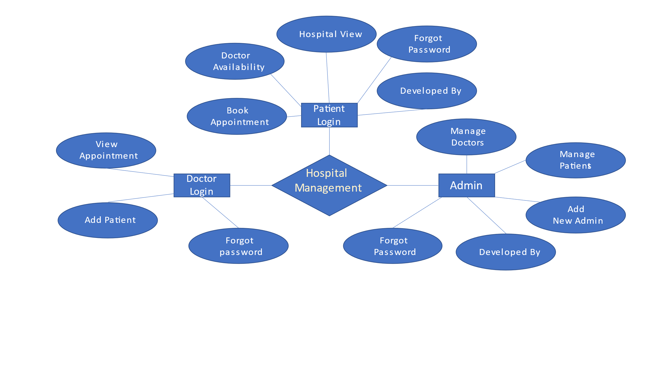
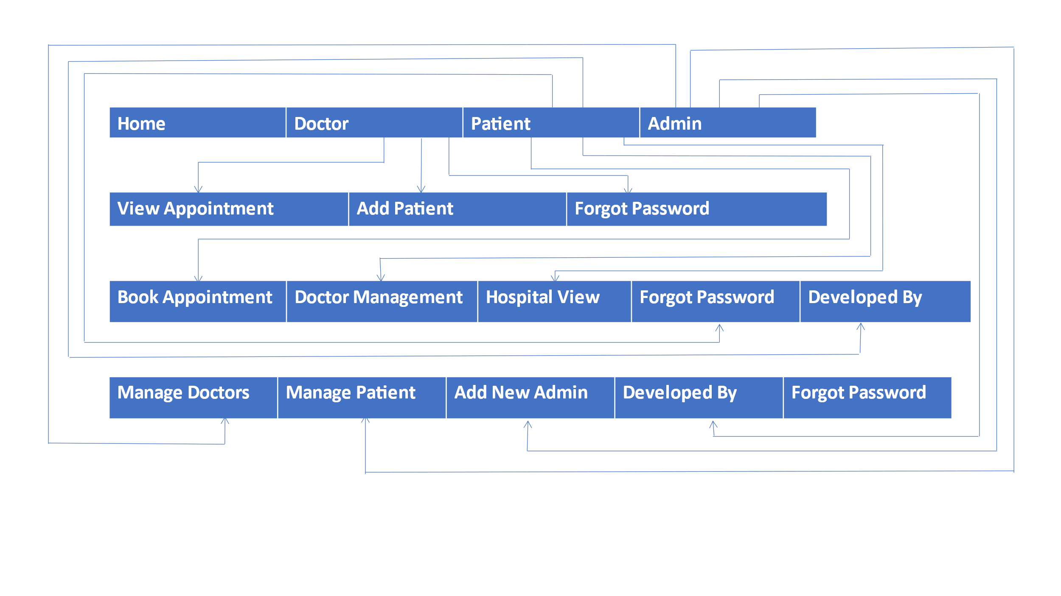
2.3 E-R Diagram
2.4 Schema Diagram

Slide 7
SYSTEM REQUIREMENT
3.1 Hardware Requirements:
64-bit versions of Microsoft Windows 10, 8
2 GB free RAM minimum, 8 GB of total system RAM recommended
2.5 GB hard disk space, SSD recommended
1024x768 minimum screen resolution
Python 2.7, or Python 3.5 or newer
3.2 Software Requirements:
XAMPP for Windows 7.4.28, 8.0.17 & 8.1.4
New XAMPP release 7.4.28 , 8.0.17, 8.1.4 Mar 18
phpMyAdmin 4.9.10 and 5.13
3.3 Toolused:
Xampp
PyCharm

Slide 8
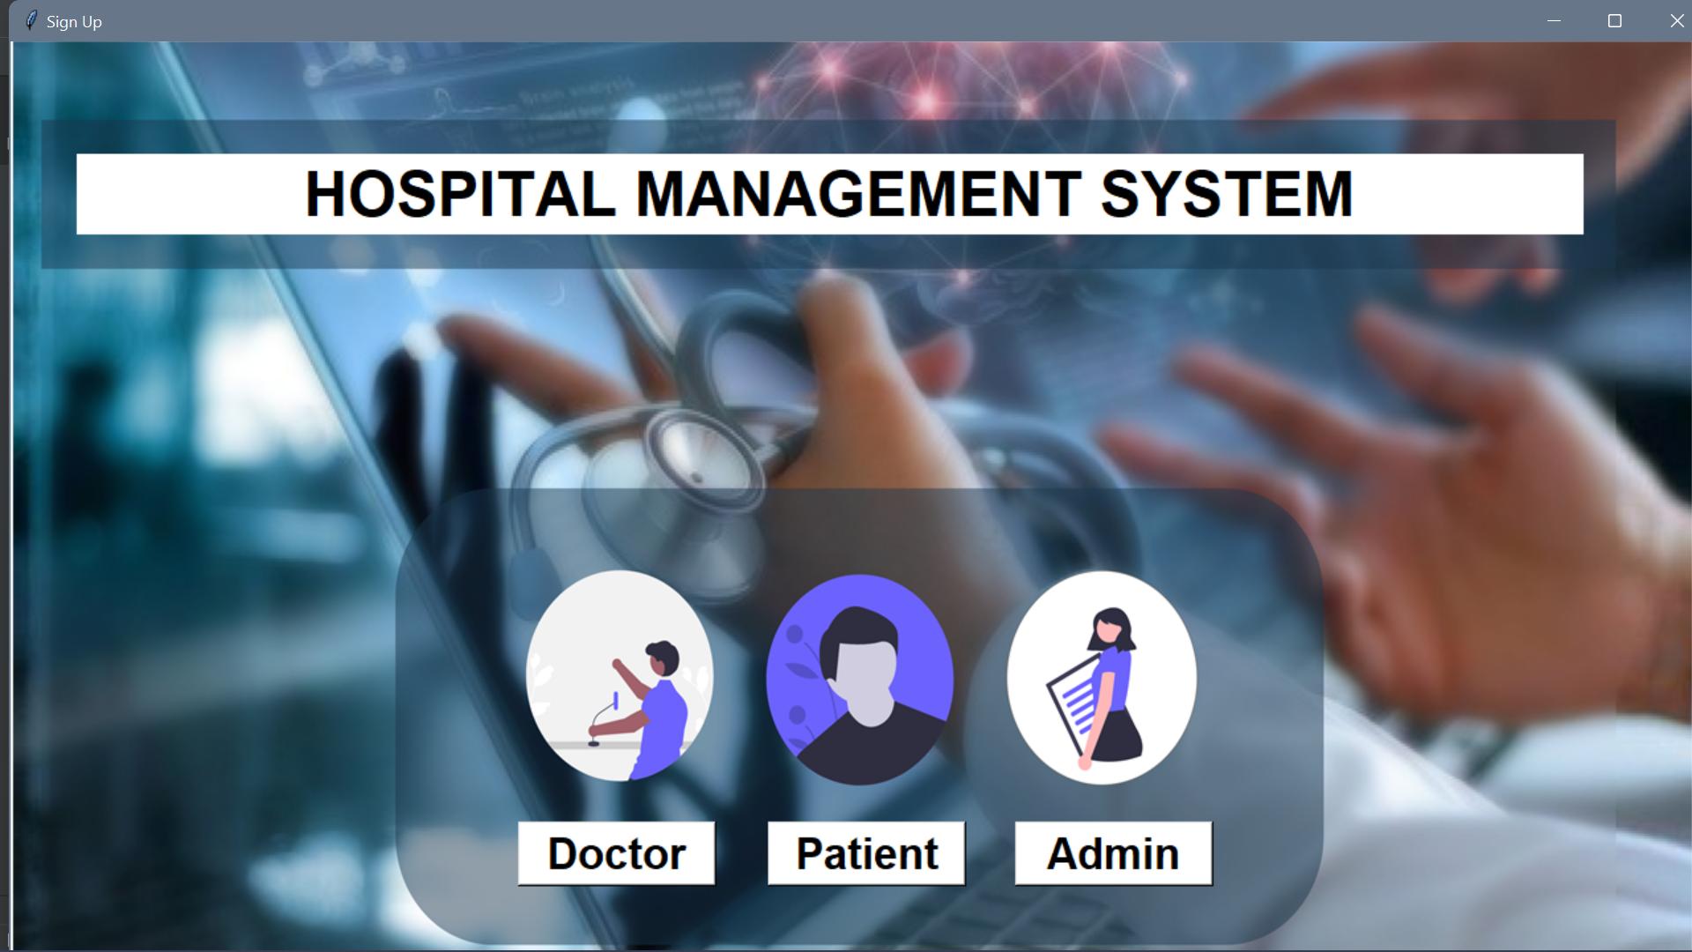
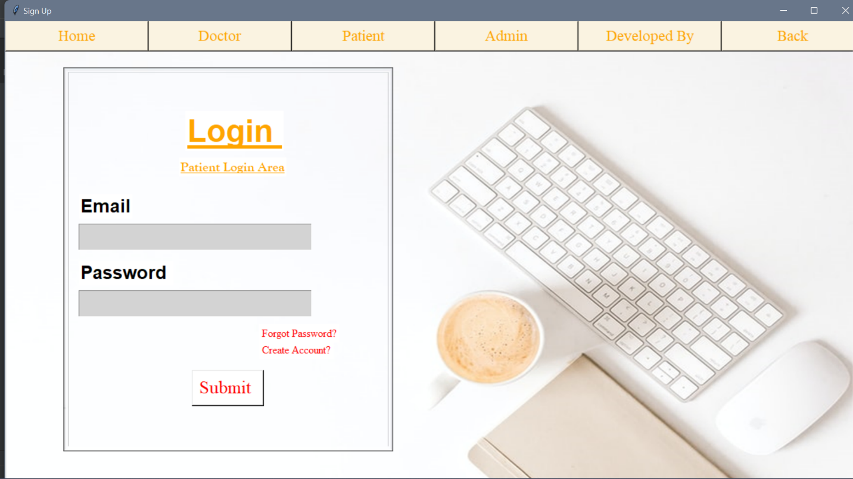
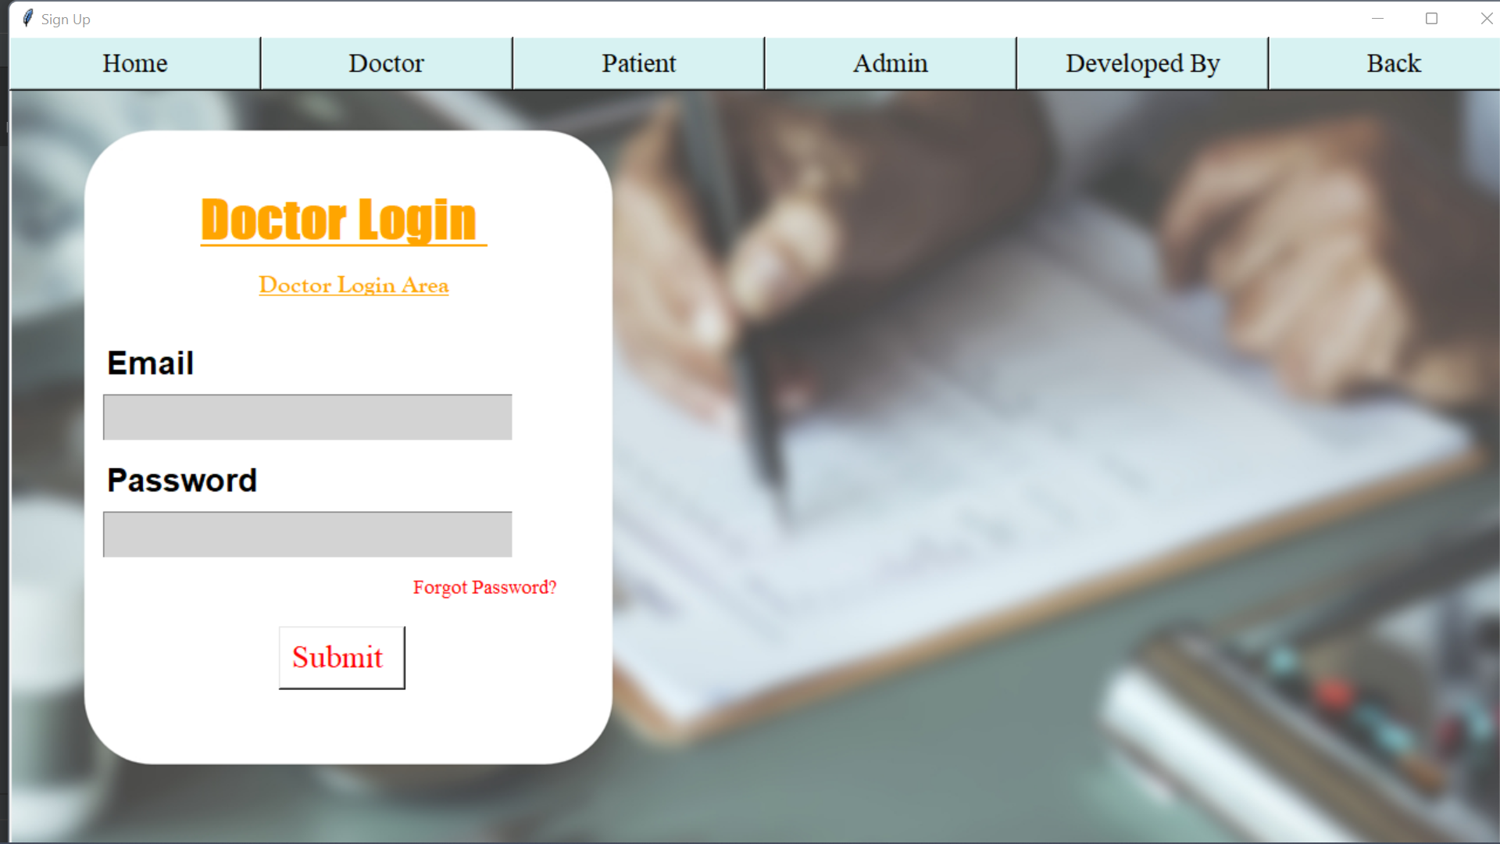
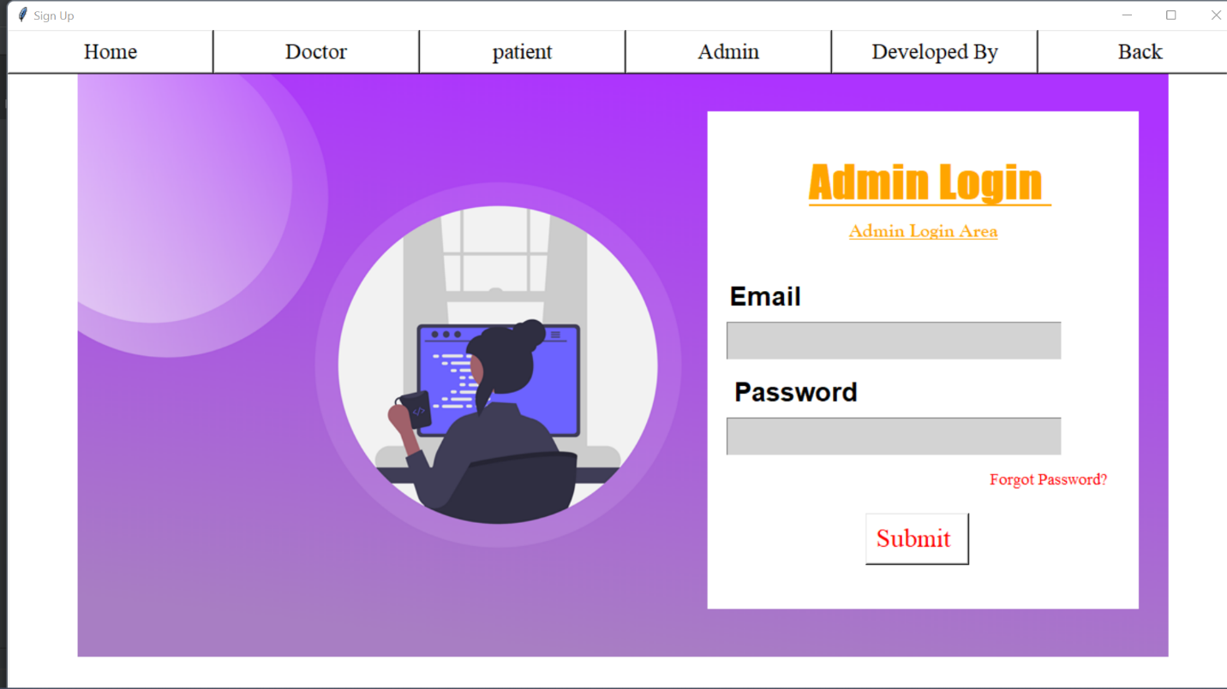
SNAPSHOTS
Fig 4.1 Homepage
Fig 4.2 Lgin Poatient Area
Fig 4.4 Admin Login Area
Fig 4.3 Doctor Login Area

Slide 9
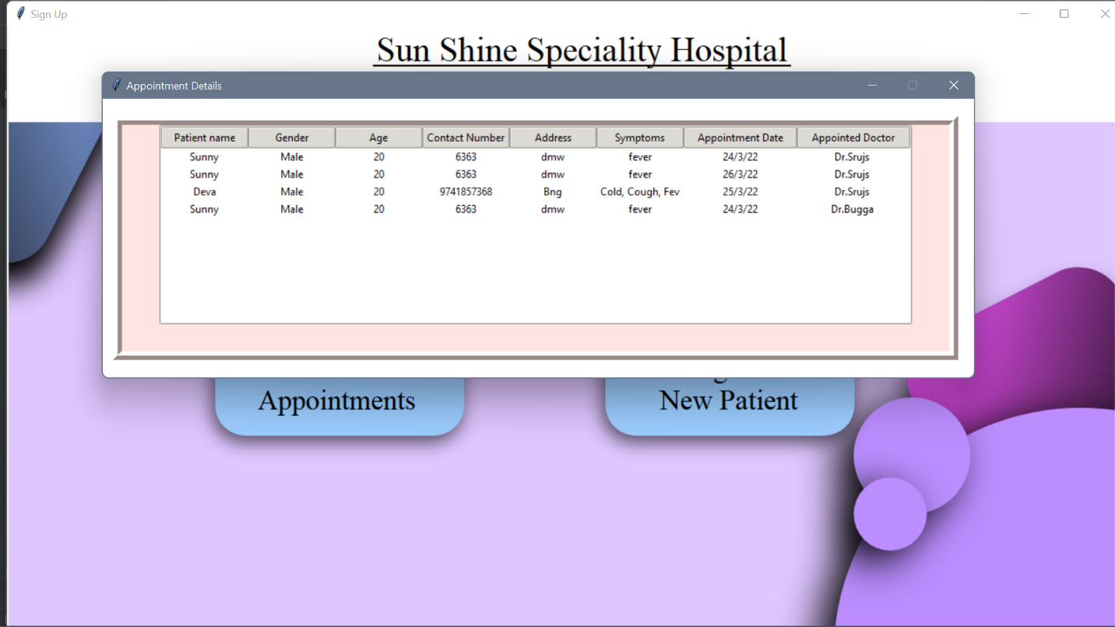
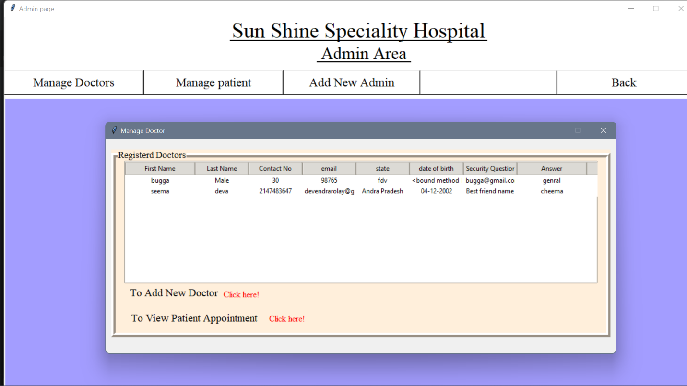
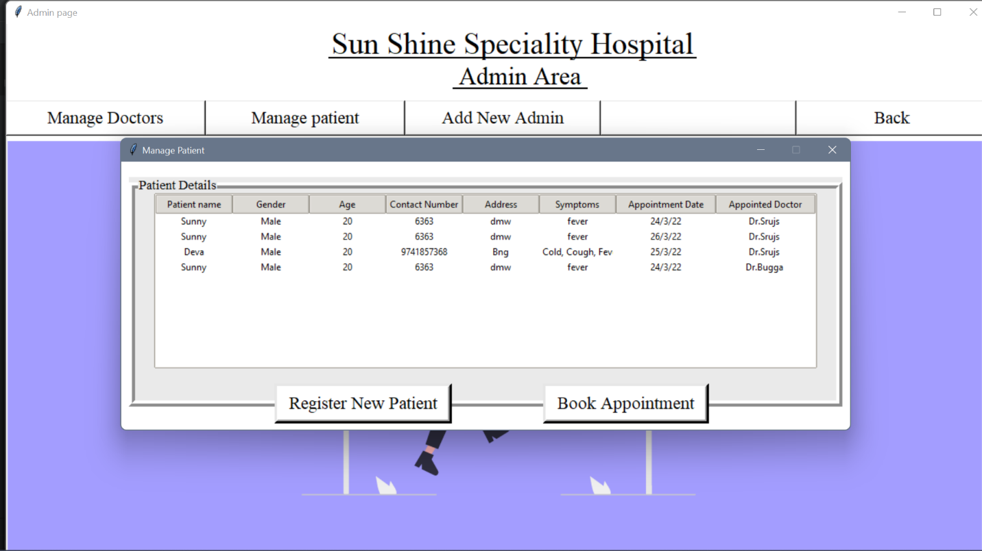
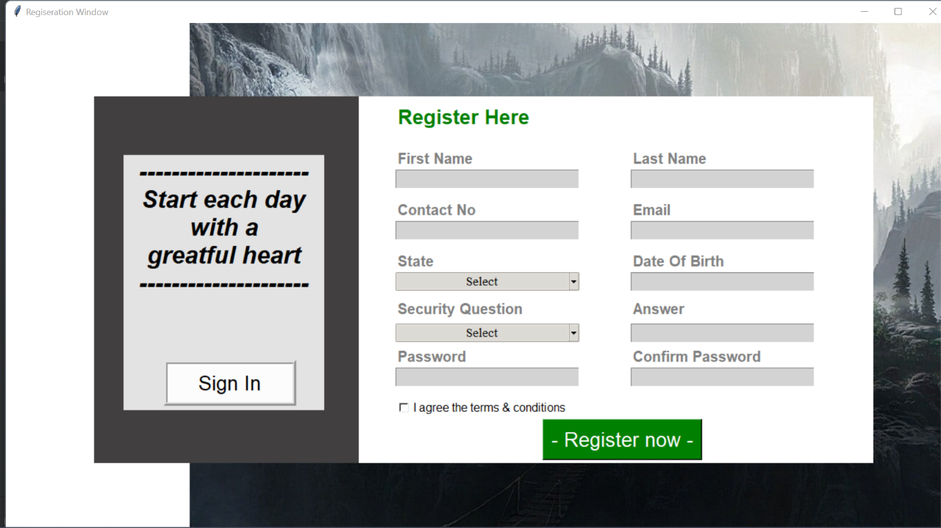
Fig 4.5 Appointment Details
Fig 4.6 Registered Doctors
Fig 4.7 Patient Appointment Details
Fig 4.8 Patient Registration Page

Slide 10
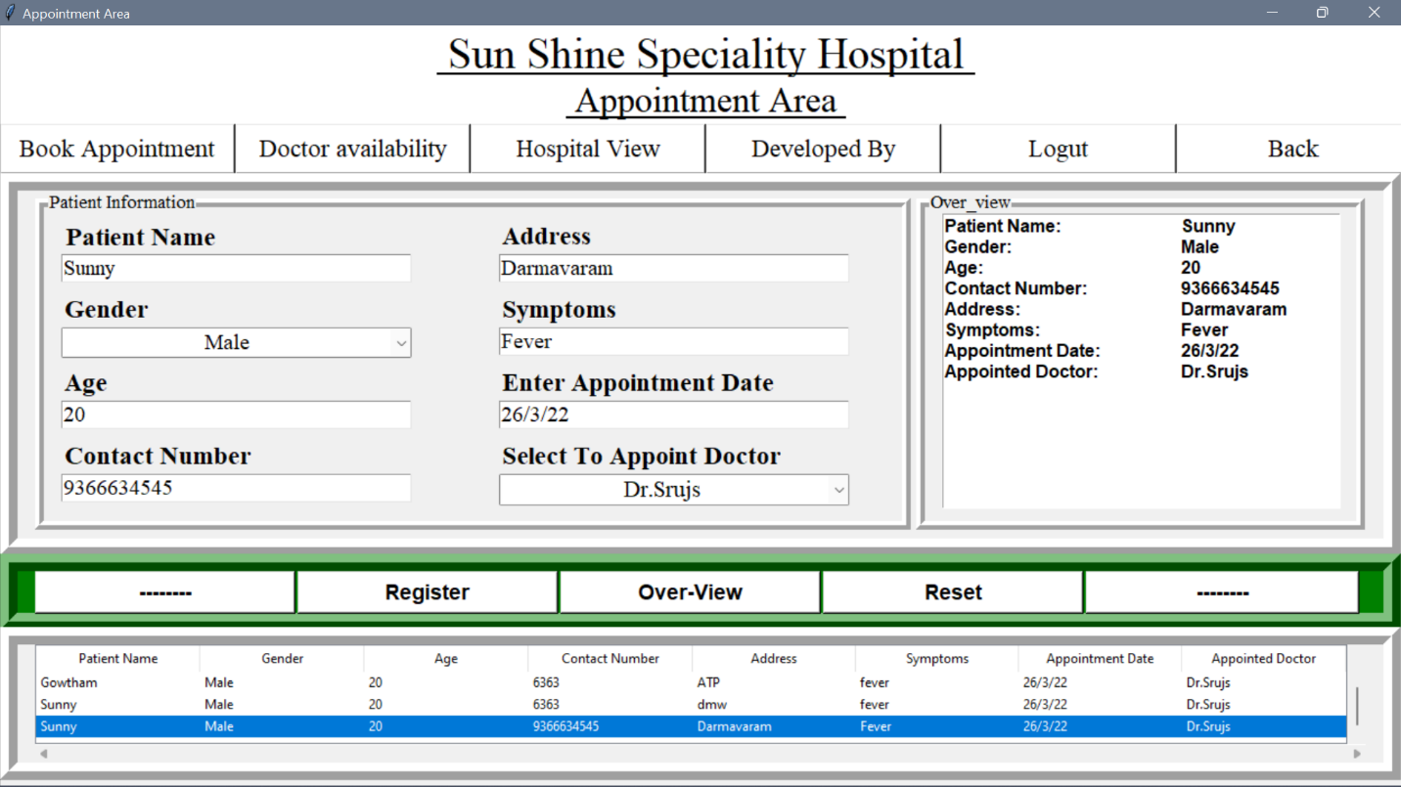
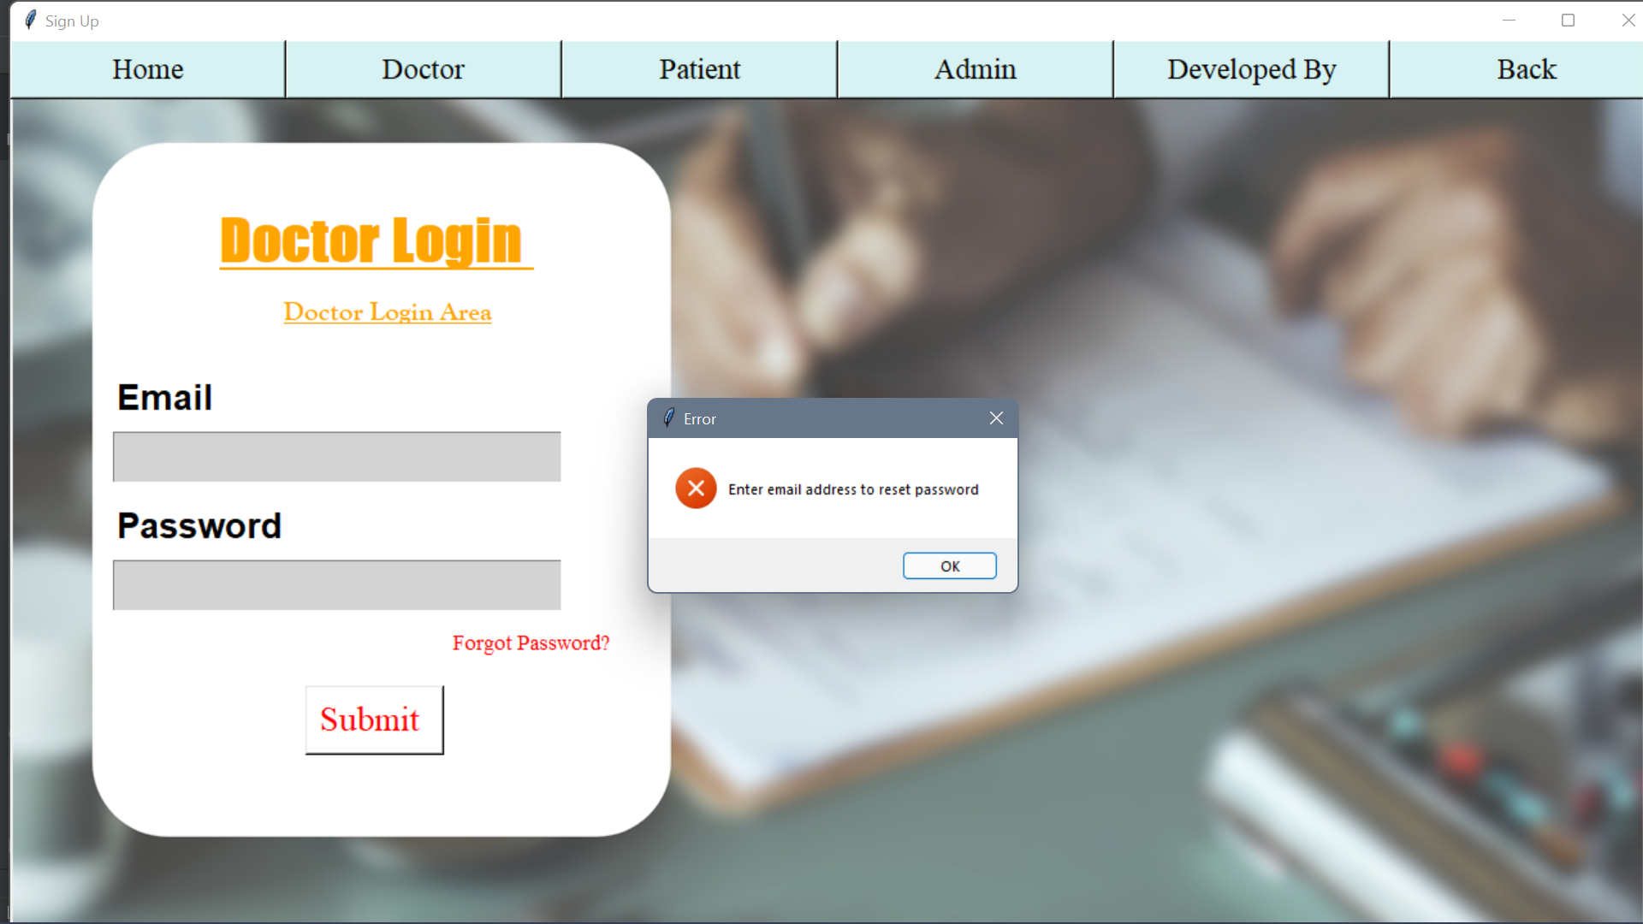
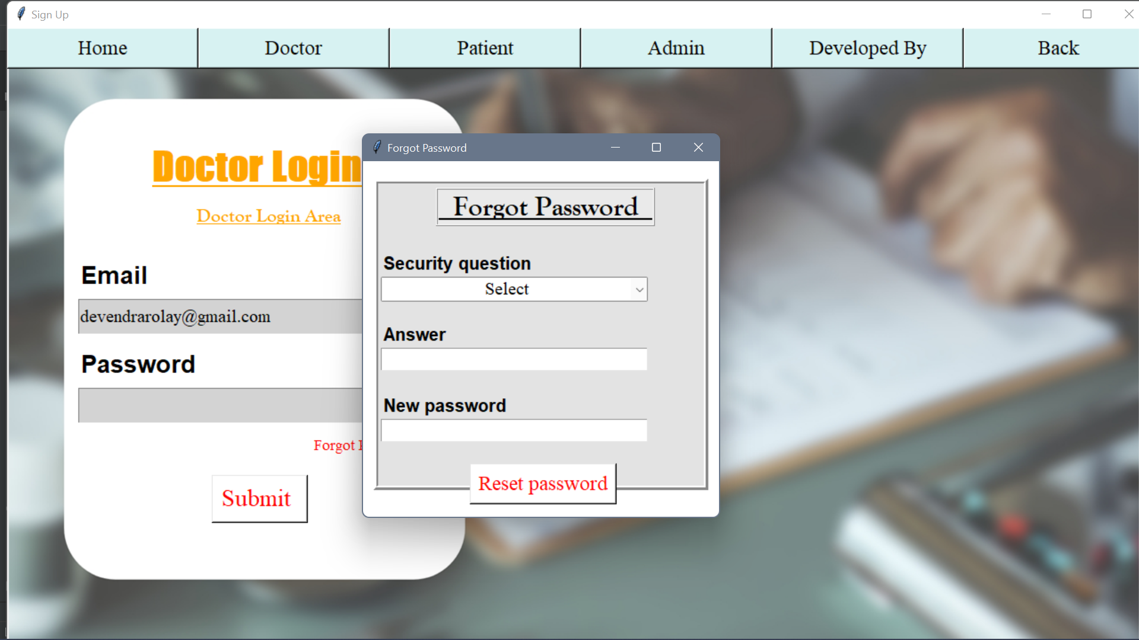
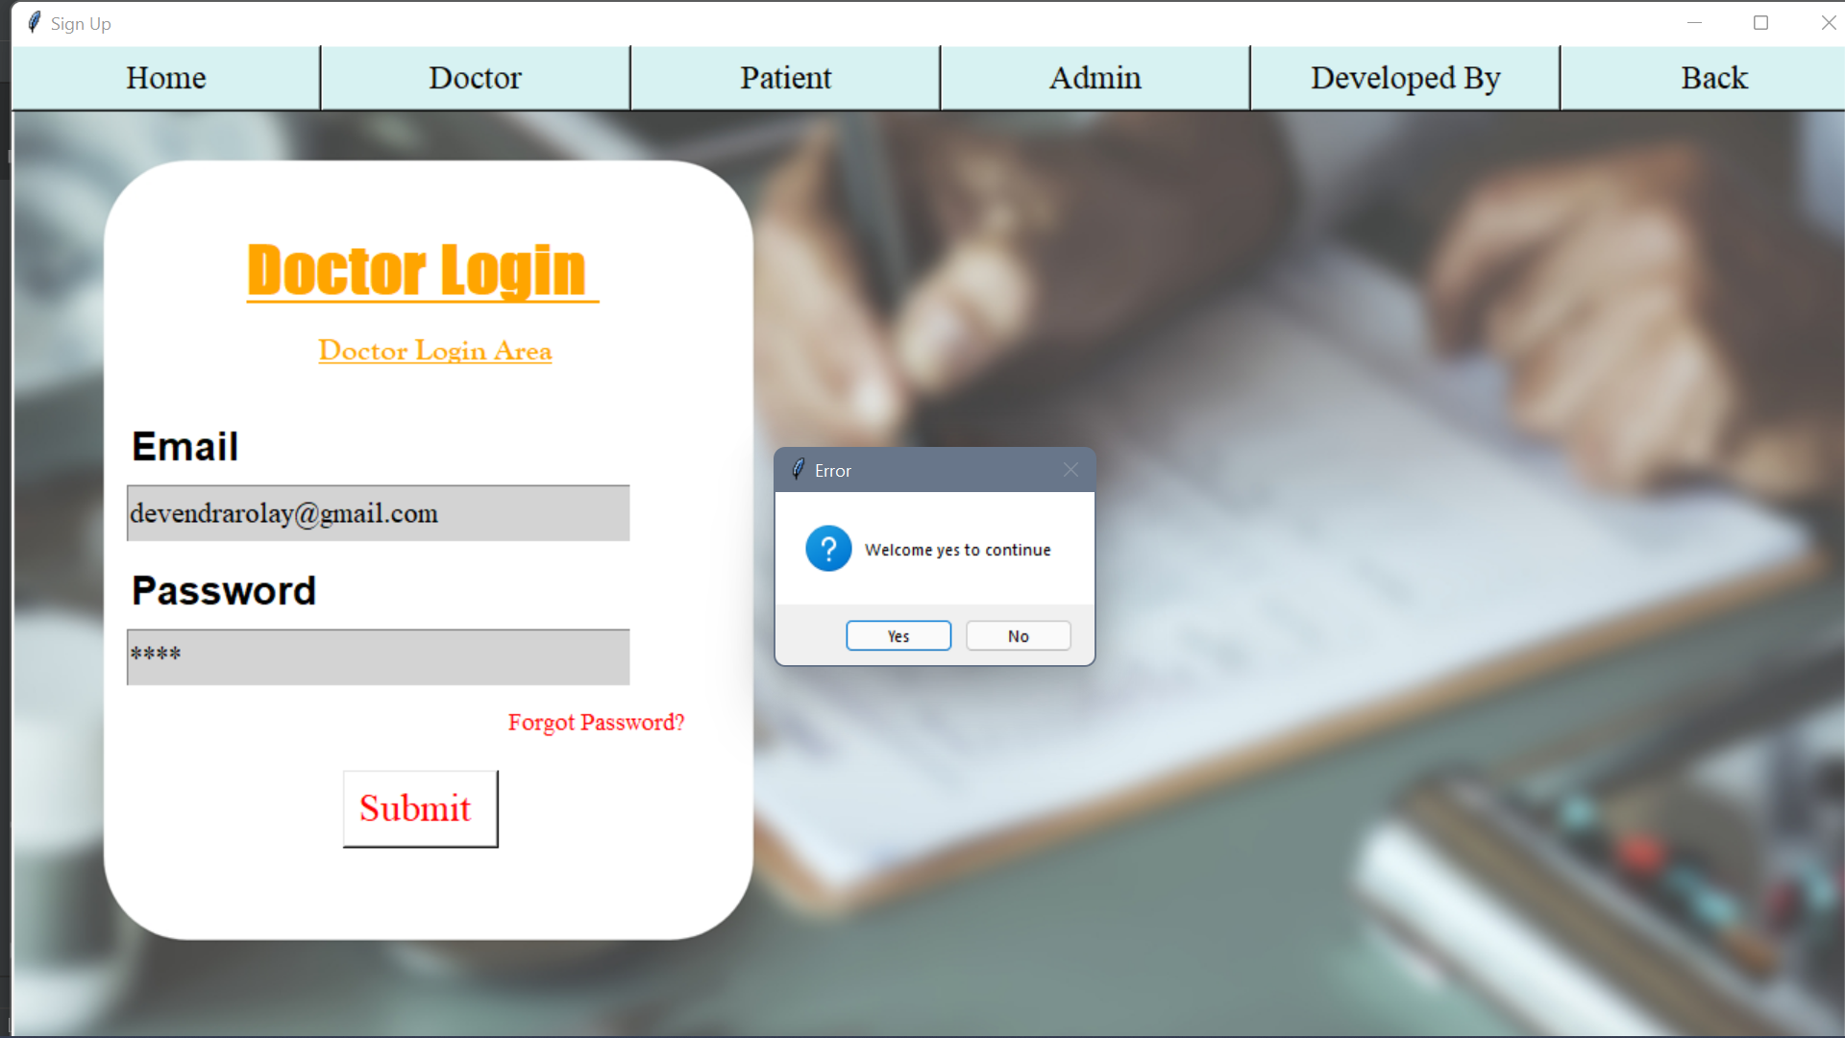
Fig 4.9 Book Apoointment Page
Fig 4.10 Validation Error box
Fig 4.12 Welcome Message Box
Fig 4.11 Forgot Password

Slide 11
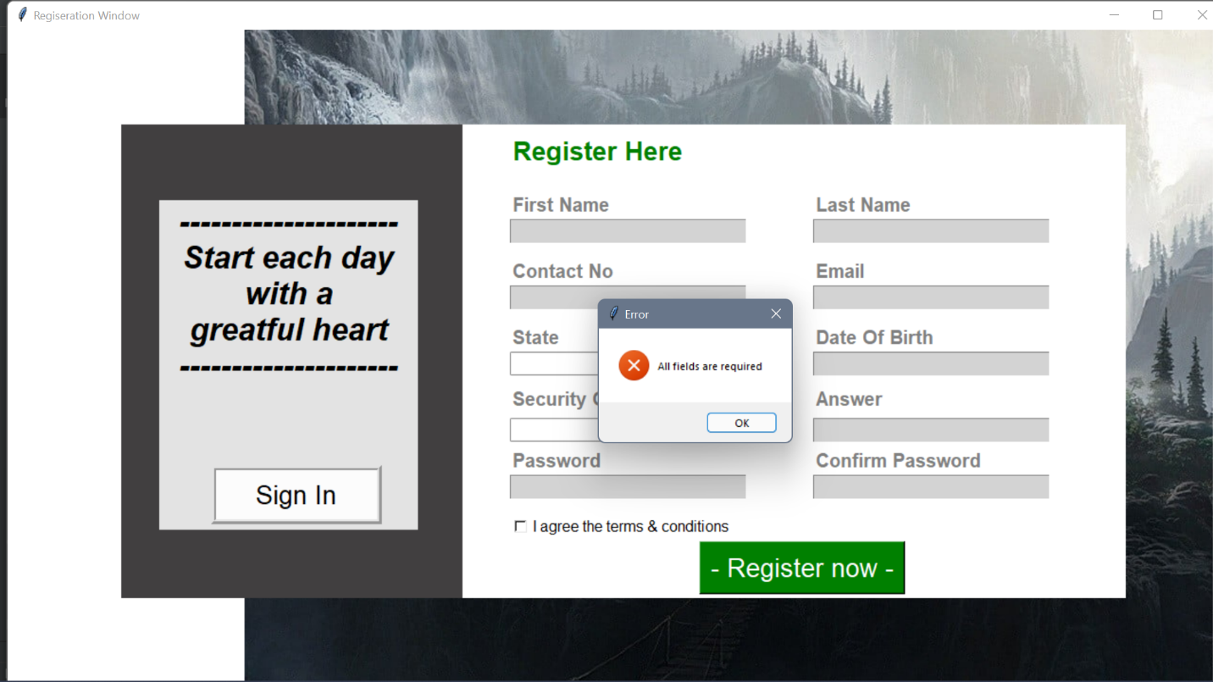
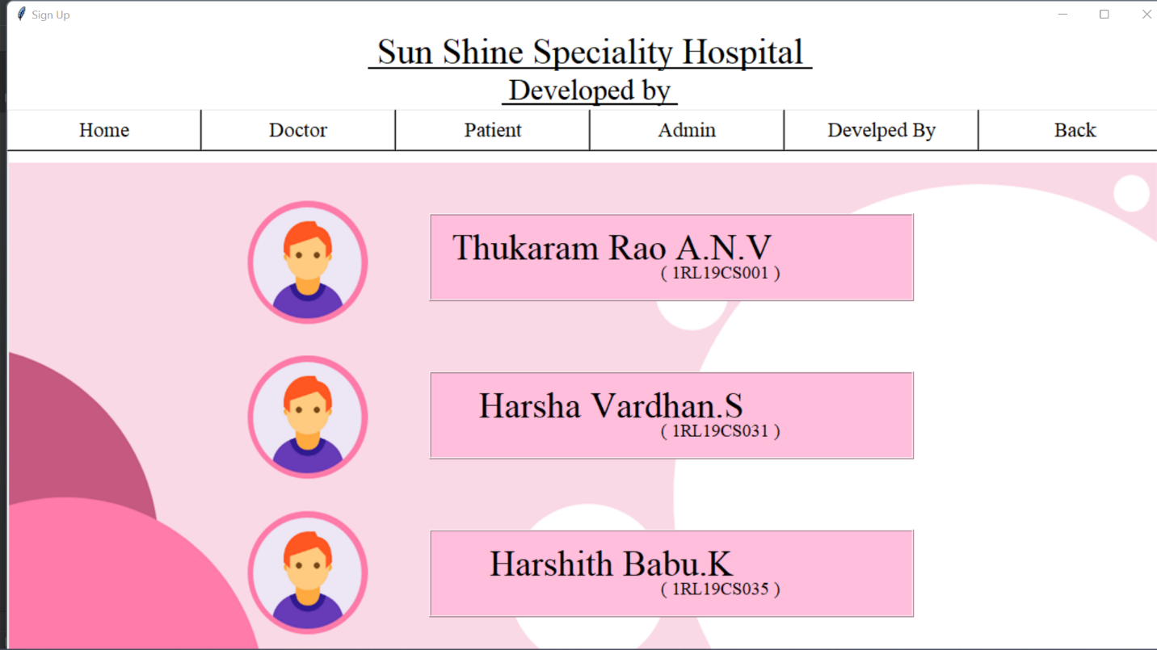
Fig4.14 Developed By
Fig 4.13 All Field Required Message Box

Slide 12
5.1 Conclusions
This project has been a rewarding experience in more than one way. The entire project work has enlightened us in the following areas.
a) We have gained an insight into the working of the HOSPITAL. This represents a typical real world situation.
b) Our understanding of database design has been strengthened this is because in order to generate the final reports of database designing has to be properly followed.
c) Scheduling a project and adhering to that schedule creates a strong sense of time management.
d) Sense of teamwork has developed and confidence of handling real life project has increased to agreat extent.
e) Initially, there were problem with the validation but with discussions, we were to implement validations.
5.2 Limitations of the system
Online payment is not available at this version.
Data delete & edit system is not available for all section.
User account not verified by Mobile SMS not available in this system.
CONCLUSION

Slide 13
REFERENCES
References:
[1] Deepak Thomas ͞”Beginning PHP 4 Databases”, Wrox Press Ltd. Paperback-17, October,2002.70-130 pp.
[2] Matt Doyle, “Beginning PHP 5.3,2nd edition”, October 2009. 150-270 pp.[3] Luke Welling, Laura Thomson. Sams
[3] PHP and MySQL Web Development, 2nd edition,Paperback- 20 February, 2003. 105-209 pp.
[4] W. Jason Gilmore “Beginning PHP 5 and MySQL 5 from Novice to Professional SECOND EDITION”, Jul 9, 2008.100-150 pp.
[5] Abraham Silber schatz, Henry F. Korth and S. Sudarshan “Sixth Edition Database System Conceptsreleased”, January 28, 2010. 206-253 pp.
[6] Server-Side Scriptinghttp://php.net/manual/en/index.php,
[7] https://www.w3schools.com/,
[8] Bootstra phttp://getbootstrap.com/,
[9] https://stackoverflow.com/,

